Slide 1

Cache Memory

Slide 2
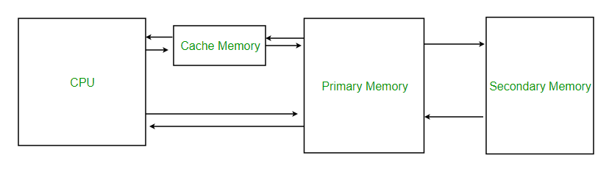
Cache Memory
Cache Memory is a special very high-speed memory.
It is used to speed up and synchronizing with high-speed CPU.
Cache memory is costlier than main memory or disk memory but economical than CPU registers.
Cache memory is an extremely fast memory type that acts as a buffer between RAM and the CPU.
Holds frequently requested data and instructions so that they are immediately available to the CPU when needed.
Used to reduce the average time to access data from the Main memory.
The cache is a smaller and faster memory which stores copies of the data from frequently used main memory locations.

Slide 3
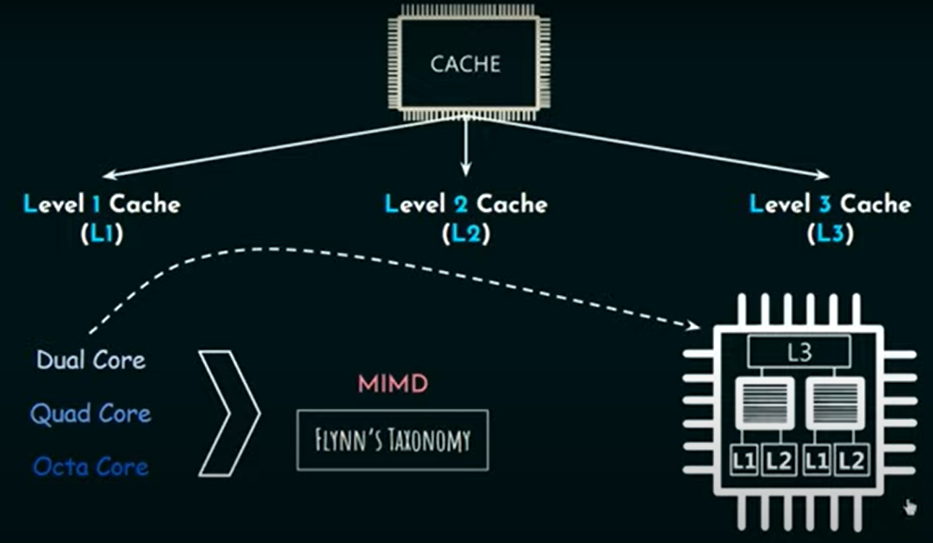
Levels of Cache Memory
L1 cache, or primary cache, is extremely fast but relatively small, and is usually embedded in the processor chip as CPU cache.
L2 cache, or secondary cache, is often more capacious than L1. L2 cache may be embedded on the CPU, or it can be on a separate chip or coprocessor and have a high-speed alternative system bus connecting the cache and CPU. That way it doesn't get slowed by traffic on the main system bus.
Level 3 (L3) cache is specialized memory developed to improve the performance of L1 and L2. L1 or L2 can be significantly faster than L3, though L3 is usually double the speed of DRAM. With multicore processors, each core can have dedicated L1 and L2 cache, but they can share an L3 cache. If an L3 cache references an instruction, it is usually elevated to a higher level of cache.

Slide 4
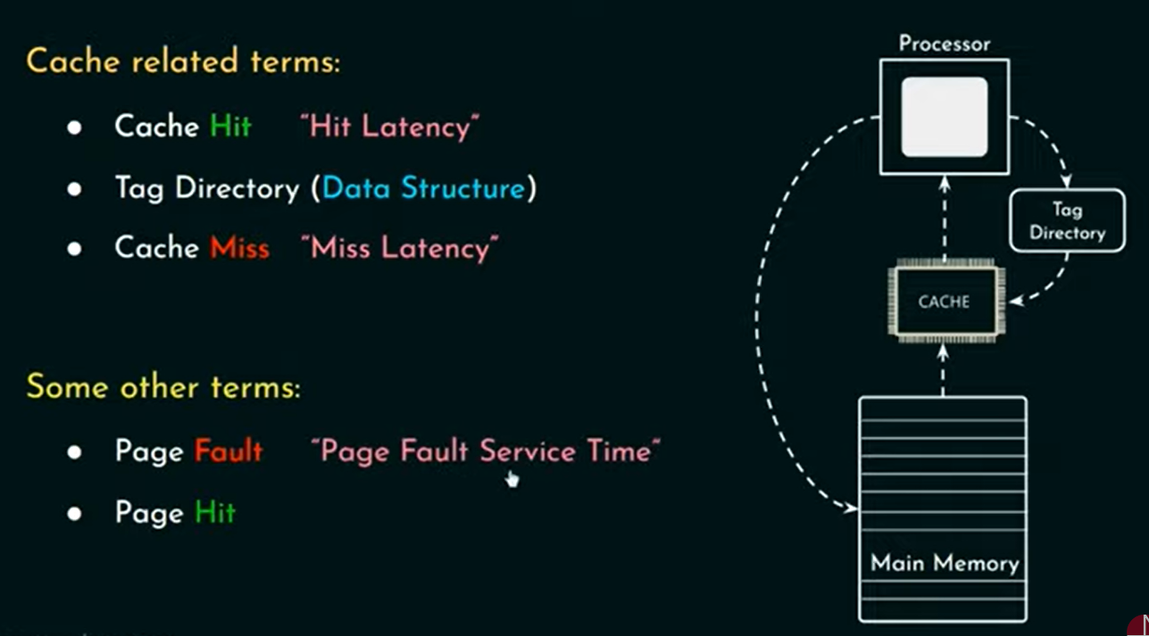
Cache Performance
When the processor needs to read or write a location in main memory, it first checks for a corresponding entry in the cache.
If the processor finds that the memory location is in the cache, a cache hit has occurred, and data is read from cache
If the processor does not find the memory location in the cache, a cache miss has occurred. For a cache miss, the cache allocates a new entry and copies in data from main memory, then the request is fulfilled from the contents of the cache.
The performance of cache memory is frequently measured in terms of a quantity called Hit ratio.

Slide 5
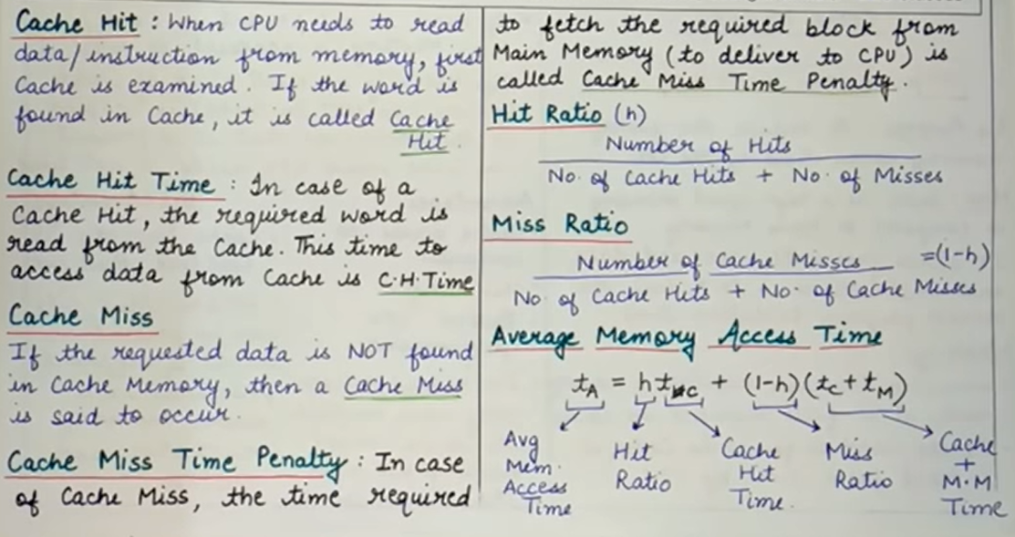
Some Important Formulas

Slide 6
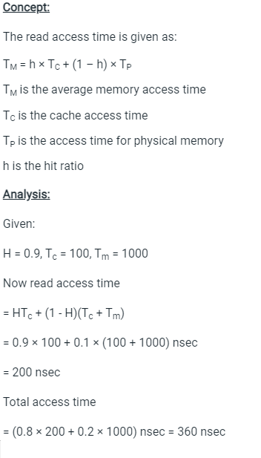


Q. The access time of cache memory is 100 ns and that of main memory is 1000 ns. It is estimated that 80% of the memory requests are for read and the remaining 20% for write operation. The hit ratio of read access only is 0.9. A write through procedure is used.
A) What is the average access time of the system considering memory read cycles only?
B) What is the average access time of the system for both read and write cycles?
C) What is the hit ratio of the system considering only memory write cycles ?

Slide 7
If cache access time is 100ns, main memory access time is 1000ns and the hit ratio is 0.9. Find the average access time and also define hit ratio.
Solution:
Given,
Cache access time = 100ns
Memory access time = 1000ns
Hit ratio = 0.9
Average access time = Hit ratio x Cache access time + (1 – Hit ratio) x Main memory access time
Using above formula:
Average access time = 0.9 x 100ns + (1 – 0.9) x 1000ns = 190ns

Slide 8
Locality of Reference Or Principle of Locality
Locality of reference refers to a phenomenon in which a computer program tends to access same set of memory locations for a particular time period.
In other words, Locality of Reference refers to the tendency of the computer program to access instructions whose addresses are near one another.
The property of locality of reference is mainly shown by loops and subroutine calls in a program.
On an abstract level there are two types of localities which are as follows −
Temporal locality
Spatial locality

Slide 9
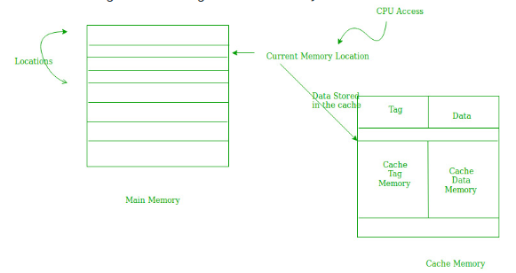
Cache Operation: Temporal Locality
Temporal Locality: Temporal locality means current data or instruction that is being fetched may be needed soon.
So, we should store that data or instruction in the cache memory so that we can avoid again searching in main memory for the same data.
When CPU accesses the current main memory location for reading required data or instruction, it also gets stored in the cache memory which is based on the fact that same data or instruction may be needed in near future. This is known as temporal locality.
If some data is referenced, then there is a high probability that it will be referenced again in the near future.

Slide 10
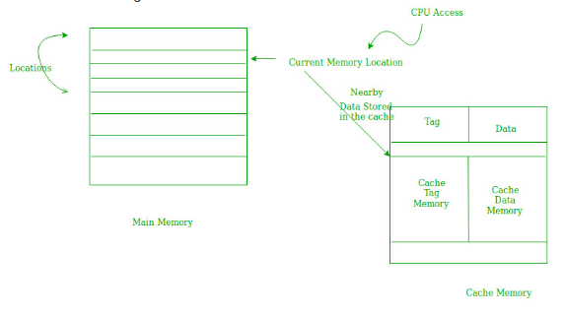
Spatial Locality
Spatial locality means instruction or data near to the current memory location that is being fetched, may be needed soon in the near future.
This is slightly different from the temporal locality.
Here we are talking about nearly located memory locations while in temporal locality we were talking about the actual memory location that was being fetched.

Slide 11
Cache Memory Access
There are two types of Cache Accesses possible whenever CPU wishes to access a particular main memory address:
Simultaneous Cache Access
Hierarchical Cache Access.
Both of them have similar kind of block representation but their working, accessing and most importantly their average memory access time is different respectively.

Slide 12
Simultaneous Cache Access
In simultaneous cache access, request for cache memory and main memory are generated simultaneously.
If CPU generated address is found in Cache Memory, then it is considered as Hit and then CPU could directly access the main memory address as well as it contents from cache memory itself and further if any sort of changes happens in Cache memory with respect of that particular then that changes will be done in Main Memory also after Cache Memory.
If CPU generate address is not found in Cache Memory, then it is considered as Miss and then CPU has to access that address from main memory and furthermore that block from main memory is moved to Cache Memory for future references as well as usage.
Simultaneous Memory Access is used for the implementation of Write Through Cache.

Slide 13
Calculation of Average Memory Access Time in Simultaneous Access
If its a hit, then CPU will access content from cache memory itself and if its a miss then therefore Main Memory will come into action.
Therefore, Average memory access time in case of Simultaneous Access will be shown below –
Average Memory Access Time = Hit ratio * Cache Memory Access Time + (1 – Hit ratio) * Main Memory Access Time
If suppose locality of reference is included here, then we use following concept to determine the Average memory access time –
Average Memory Access Time = Hit ratio * Cache Memory Access Time + (1 – Hit ratio) * Time required to access a block of main memory.
where, Time required to access a main memory block = block size * Time required to access main memory.
If suppose block transfer time is also included here, then we use following concept to determine the Average memory access time –
Average Memory Access Time = Hit ratio * Cache Memory Access Time + (1 – Hit ratio) * (Cache Memory Access Time + Time required to access a block of main memory)
where, Time required to access a main memory block = block size * Time required to access main memory

Slide 14
Hierarchical Cache Access
In hierarchical cache access only the faster memory (which is Cache memory) is accessed first.
Afterwards if address generated by CPU is not found in Cache memory, then along with searching time in Cache memory main memory access time will also be counted.
By default, many computer designs are made using this hierarchical access only because this cache access reduces average memory access time due to locality of reference concept (in which for a particular address of main memory we just bring its previous and its next address also in form of block so that in future less memory access is required).

Slide 15
Calculation of of Average Memory Access Time in Hierarchical Access
If its a hit, then CPU will access content from cache memory itself and if its a miss then Along with Cache Memory Access Time Main Memory Access Time is also counted.
Therefore, Average memory access time in case of Hierarchical Access will be shown below –
Average Memory Access Time = Hit ratio * Cache Memory Access Time + (1 – Hit ratio) * (Cache Memory Access Time + Main Memory Access Time)

Slide 16
Numerical
Example 1: In 2-level hierarchy, if the top level has an access time of 10ns and the bottom level has an access time of 60ns, what is the hit rate on the top level required to give an average access time of 15ns?
Explanation: According to example, we have been given
Cache Access time (top level) = 10ns and
Main memory access time (bottom level)= 60ns and
Average memory access time = 15ns.
Therefore, we will apply the above illustrated concept of hierarchical access(because in question it was written 2-level hierarchy) for calculating the memory access time
Average memory access time = Hit ratio * Cache memory access time + (1 – Hit ratio) * (Cache Memory access time + Main memory access time)
15ns = 10 * Hit ratio + (1 – Hit ratio) * (10ns + 60ns)
15ns-70ns = -60 * Hit ratio
Hit ratio = 55 /60 = 11/12 = 0.9 (Ans.)

Slide 17
In two level hierarchy, the top level has an access time of 10ns, and bottom level has an access time of 50ns, the hit rate on the top level is 90%. If the block size of cache is 16 bytes, then what is the average memory access time required? (Consider the system uses locality of reference)
Explanation – Given: Cache memory access time (top level)= 10ns Main memory access time (bottom level) = 60ns Therefore, we will apply the above learnt concept for calculating the average memory access time when we have to consider locality of reference concept into consideration.
Average memory access time = Hit ratio * Cache memory access time + (1 – Hit ratio) * ((Block size * main memory access time) + cache memory access time)
Average memory access time = 10 * 0.9 + (1 – 0.9) * (16 * 5 + 10) = 9 + (0.1) * (800 + 10) = 9 + 81 = 90ns (Ans.)

Slide 18
In two level hierarchy, the cache has an access time of 12ns and the main memory access time of 120ns, the hit rate of cache is 90%. If the block size of cache is 16 bytes, then what is the average memory access time including Miss Penalty? (Miss Penalty: Time to bring main memory block to cache memory when cache miss occurs)
Explanation: Given
Cache memory access time= 12ns Main memory access time= 120ns Therefore, we will use the above learnt concept for calculating the average memory access time when block transfer occurs from main memory to cache memory on cache miss.
Average memory access time = Hit ratio * Cache memory access time + (1 – Hit ratio) * (Cache memory access time + (Block size * Main memory access time)+ Cache memory access time due to block transfer)
Average memory access time = 0.9 * 12 = (0.1) * (12ns + 16 * 120 ns + 12ns) = 10.8ns + 194.4ns = 205.2ns (Ans.)

